Slide 1



Decrypting QoE in an Encrypted Internet – AI to the Rescue
Sarah Wassermann
Michael Seufert, Pedro Casas

Slide 2







QoE Monitoring
QoE monitoring
system
Service/App KPIs:
Rebufferings
Resolution
Quality switches
User KPIs:
Satisfaction
Engagement
Churning
Network KPIs:
Throughput
Latency
Packet loss

Slide 3





Why is QoE Relevant?
Customer experience
Strong competition between service providers
Customer perception becomes more and more relevant
Service providers need to avoid customer churn and attract new users
User engagement
Poor quality (for ex. many rebufferings) reduces user engagement
Service providers need to integrate QoE into the core of their network-monitoring systems

Slide 4



Impact of Bad QoE
Bad QoE has significant impact on large companies
Amazon
Every additional 100 ms of page-load time could cost them 1% of their sales, and a page-load slowdown of just one second could turn into a $1.6 billion loss in sales each year
If page takes additional 400 ms to load, 5–9% users browse away
Google
Slowing search results down by 400 ms, they could loose 8 million searches per day (Google Ads!)

Slide 5





Difficulties with End-to-End Encryption (1)
Application
HTTPS
Application
DPI
Transport
QUIC
Transport
Network
Network
Link
QoE metrics
Link
Physical
Physical
User
ISP
HTTPS and QUIC make previous approaches no longer applicable – lack of visibility for ISPs
Solution I – monitoring directly at the end devices
Solution II – monitoring at the network core

Slide 6

Difficulties with End-to-End Encryption (2)
Monitoring directly at the end devices
Advantage: we can capture application-layer quality metrics (stallings, quality switches, etc.)
Drawback: the metrics are hard to capture directly from the official video app; need root access or an embedded player
Monitoring at the network layer
Advantage: we can capture network-level information without having root access on the smartphone, easy to do with the Android API
Drawback: because of E2E encryption, standard in-network monitoring tools become inaccurate

Slide 7


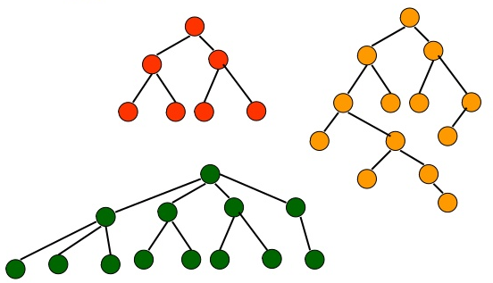



Modelling Mobile Video-Session Quality with AI (1)
Prediction of session-based video-quality metrics for YouTube mobile
Dataset: 3000+ sessions recorded from 360+ Android users worldwide between 2014 and 2018, using YoMoApp
275 network-related features extracted from encrypted traffic
Easily accessible through the Android API, without root privileges
After feature selection, 30 features yield almost identical prediction accuracy
Highly encouraging results, high true-positive rates (TPR)
Random forest used as a prediction model
Can we predict video quality solely based on data extracted from encrypted network traffic?

Slide 8
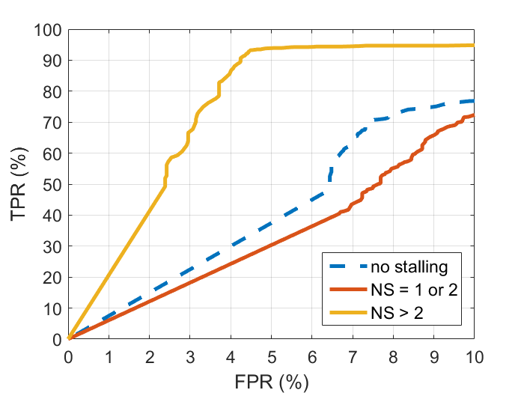
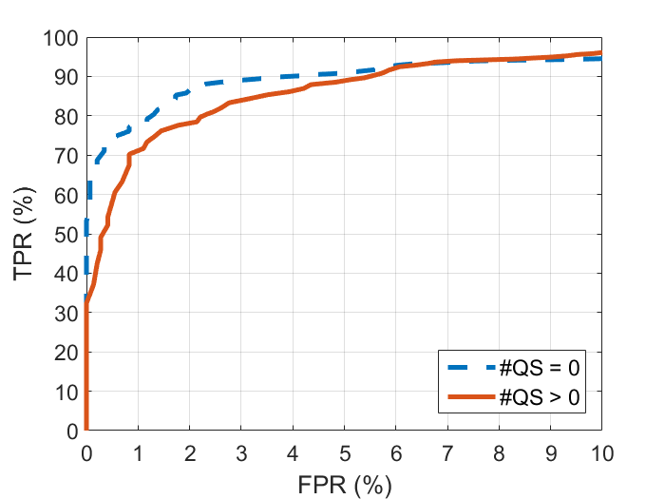
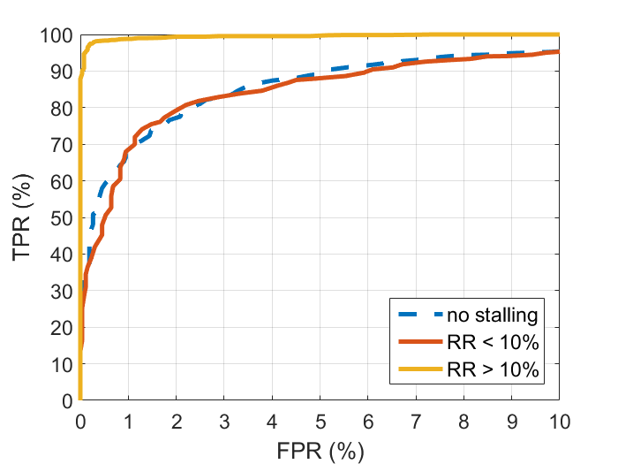

Modelling Mobile Video-Session Quality with AI (2)
# stallings
No stalling
1 or 2 stallings
> 2 stallings
# quality switches
No switches
> 0 switches
Rebuffering ratio
No rebuffering
Rebuffering ratio < 10%
10% ≤ rebuffering ratio
# stallings ROC curve
# quality switches ROC curve
Rebuffering ratio ROC curve
Beauty is in the Eye of the Smartphone Holder – A Data Driven Analysis of YouTube Mobile QoE N. Wehner, S. Wassermann, P. Casas, M. Seufert, F. Wamser in Proceedings of the 14th International Conference on Network and Service Management (CNSM), Rome, Italy, 2018
Machine Learning Models for YouTube QoE and User Engagement Prediction in Smartphones S. Wassermann, N. Wehner, P. Casas in Proceedings of the Workshop on AI in Networks (WAIN) 2018, Toulouse, France, 2018
On the Analysis of YouTube QoE in Cellular Networks through in-Smartphone Measurements S. Wassermann, P. Casas, M. Seufert, F. Wamser in Proceedings of the 12th IFIP Wireless and Mobile Networking Conference (WMNC), Paris, France, 2019

Slide 9

Stream-based Video-Quality-Metric Prediction (1)
Stream-based predictions in much finer time granularity, every second
3 different groups of features (207 in total)
Snapshot features: 69
Trend features: 69
Cumulative features: 69
Benchmarking of multiple machine-learning models
Decision tree, random forest, neural network, SVM…
Tree-based models gave best results
Feature selection shows cumulative features are the most relevant ones
Can we predict video quality with network traffic while streaming a video?
t₀

Slide 10
Stream-based Video-Quality-Metric Prediction (2)
A few words about the dataset…
15,000+ YouTube sessions with more than 4,600,000 time slots collected between June 2018 and February 2019
TCP and QUIC sessions
Monitoring framework based on Selenium and JavaScript scripts, measuring all relevant metrics at the different layers of the communications stack
Diverse recording conditions: WiFi/cellular, different ISPs, different geographic locations, etc.
Bandwidth limitations: 20Mbps, 5Mbps, 3Mbps, 1Mbps, 300kbps + fluctuations

Slide 11
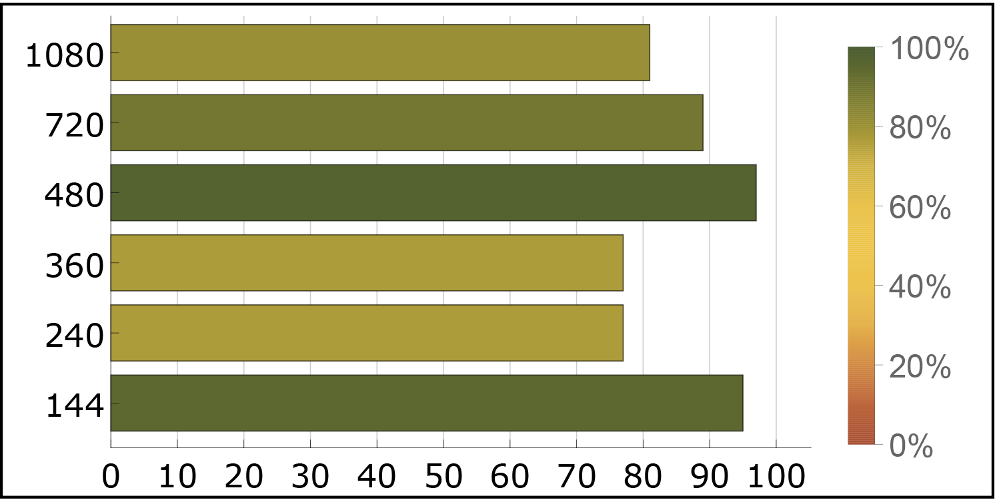
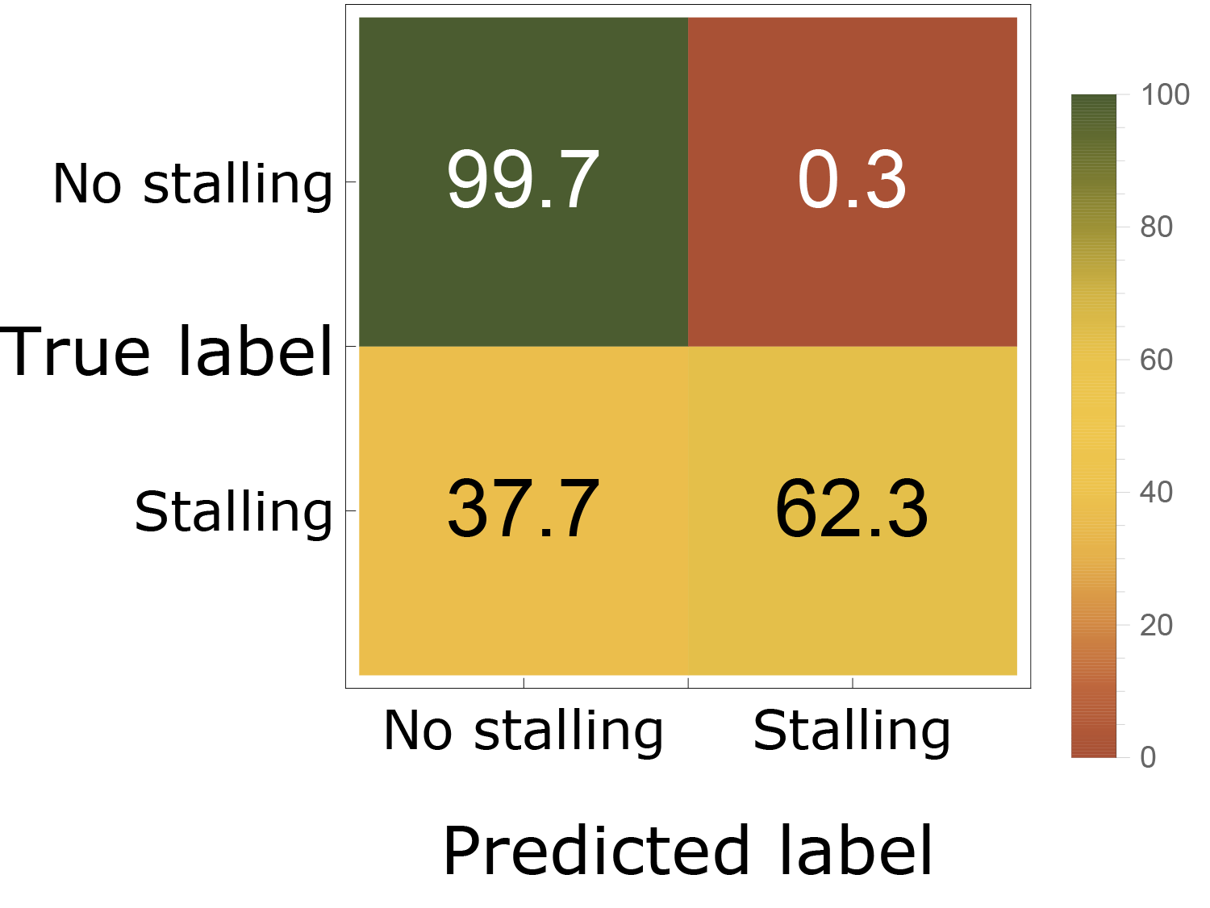
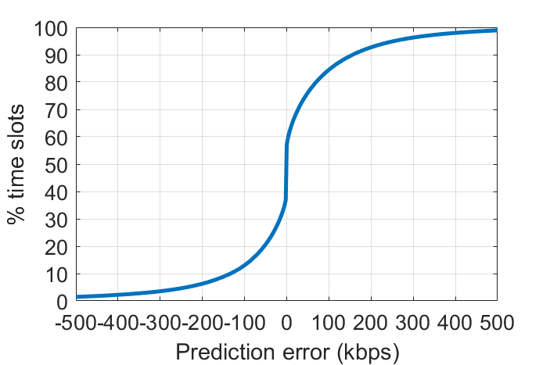
Stream-based Video-Quality-Metric Prediction (3)
Resolution
144p, 240p, 360p…
Average bitrate
Exact value
Stallings
Stalling or not?
Resolution recall
Average bitrate error

Slide 12
Stream-based Video-Quality-Metric Prediction (4)
What are we doing differently from others?
Operational deployment is the most important point for us
Very fine-grained analysis (1 sec. resolution)
The used features are completely knowledge independent (for ex. no chunk detection)
3 different sets of features (snapshot, trend, cumulative)
Very diverse dataset (WiFi/cellular network, different ISPs and geographic locations, different network conditions)
Constant-time feature computation

Slide 13
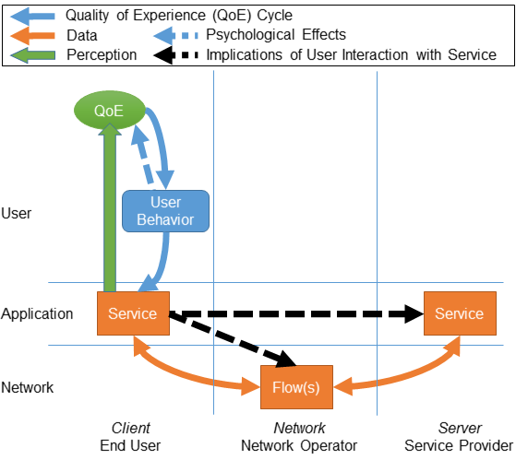

Towards Proactive QoE-aware Traffic Management
ISPs transition to QoE-aware traffic management, aiming to improve quality of Internet applications
The relationship between network and QoE mostly considered as a one-way street
BUT QoE influences user behaviour which in turn influences network traffic!
Some user interactions might give information about QoE!
Moving towards proactive QoE-aware traffic management
Adjust network conditions in time to avoid QoE degradations
Predict changing conditions and requirements
Predict quality metrics
Predict user interactions
Considering User Behavior in the Quality of Experience Cycle: Towards Proactive QoE-aware Traffic Management M. Seufert, S. Wassermann, P. Casas in IEEE Communications Letters, vol. 23, no. 7, pp. 1145-1148, 2019

Slide 14

Thanks for listening!

